Slide 1
ACT Treatment Engagement in Individuals with Neurofibromatosis and Chronic Pain
Staci Martin, PhD
National Cancer Institute, NIH
July, 2020

Slide 2
Neurofibromatosis type 1 (NF1)
Autosomal dominant condition affecting 1:3500
Cancer predisposition syndrome
MPNST: 10% lifetime risk, 10-year overall survival rate = 52%
Symptoms highly variable
Plexiform Neurofibromas (PNs)
Dermal tumors
Scoliosis
Glomus tumors
Chronic headaches
Gastrointestinal problems
New or worse pain – malignancy?

Slide 3
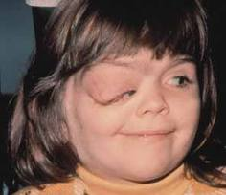
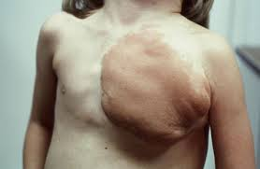
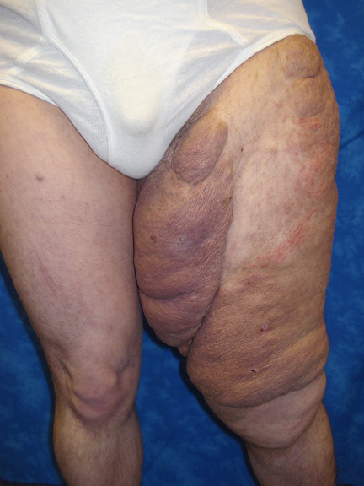

Slide 4
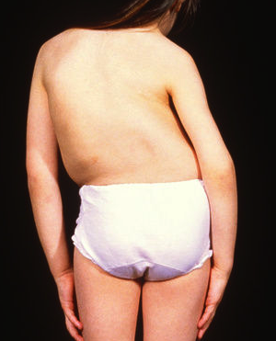
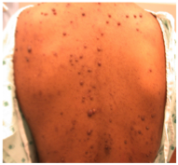
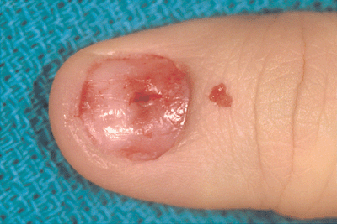
Symptoms highly variable
Plexiform Neurofibromas (PNs)
Dermal tumors
Scoliosis
Glomus tumors
Chronic headaches
Gastrointestinal problems
New or worse pain – malignancy?

Slide 5
Pain in NF1
Pain has been reported in 53% of youth with NF1 and PNs (Kim et al., 2009)
Pain interferes with functioning even among youth taking pain medication (Wolters, Burns, Martin et al., 2015)
Less information about pain in adults with NF1
No randomized controlled trials of psychological interventions for people with NF1 and PNs who have chronic pain

Slide 6
Treatment Engagement
Working with patients in clinic or online is only part of the equation
Patient-therapist interaction +
Practicing techniques in = daily life
Successful change!

Slide 7
Treatment Engagement
Extent to which individuals engage in ACT techniques and practice ACT-consistent skills outside of sessions
Batink et al (2016) examined the effectiveness of a mobile ACT intervention and noted that self-reported engagement in ACT exercises in daily life was not significantly related to treatment effects.

Slide 8
Main RCT Study
Primary Objective
To evaluate the effects of a mixed-methods (in-person and online) ACT intervention on pain interference among adolescents and adults with NF1, PNs, and chronic pain compared to a wait list control group

Slide 9
Current Sub-study Hypotheses
1) Participants who practice ACT techniques at home more frequently will show a greater reduction in pain interference.
2) Pain inflexibility and pain acceptance will mediate the relationship between treatment engagement and pain interference.

Slide 10
Methods
Eligibility
16-59 years of age with confirmed diagnosis of NF1 and a plexiform tumor
Chronic pain for > 3 months
Pain interferes with functioning (PII mean score > 2)
Regular access to internet
No new treatments for pain or tumors planned

Slide 11
Intervention
In Person
Two 2-hour sessions
Patients learned and practiced mindfulness and defusion techniques
Acceptance techniques re: unpleasant thoughts about their pain
Completed workbook with values exercises and goal-setting
At home (8 weeks)
Weekly email assignments
Biweekly video chat
Audio recordings of exercises
Reading materials
(Adapted from Dahl et al., 2005; Wicksell et al., 2007; Vowles et al., 2009; Masuda et al., 2011)

Slide 12
8-week At-home Phase
Choose 2 values
Establish a short-term goal, medium-term goal, long-term goal
Specific, meaningful, realistic

Slide 13
Measures
Domain | Measure
Pain Interference | Pain Interference Index (PII)
Pain Intensity | Numeric Rating Scale (NRS-11)
Pain Anxiety | Pain Anxiety Symptoms Scale (PASS-20)
Depression | Center for Epidemiological Studies of Depression (CES-D)
Quality of Life | PedsQL – NF Module (ADLs, Physical Fx)
Pain Acceptance | Chronic Pain Acceptance Questionnaire (CPAQ)
Pain Inflexibility | Psychological Inflexibility in Pain Scale (PIPS)
Perceived change | Global Impression of Change Scale
Treatment Engagement | ACT Inventory

Slide 14
Global Impression of Change

Slide 15
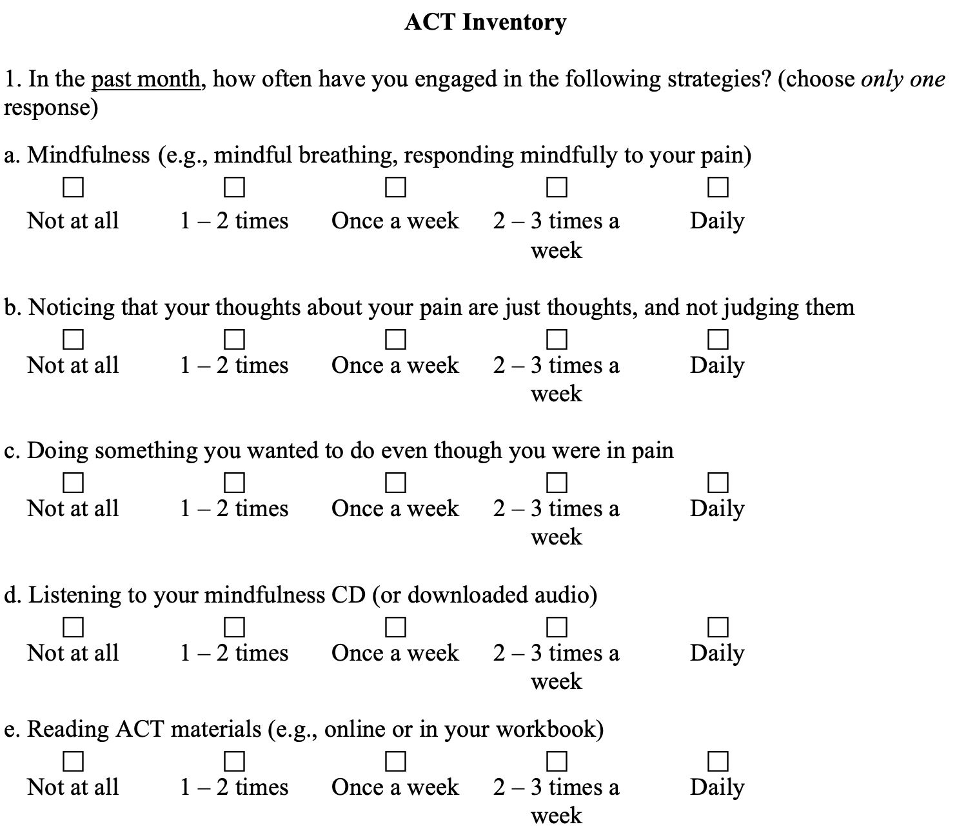
ACT Inventory

Slide 16
ACT Inventory

Slide 17
Results
Participants (N = 62)
Variable | M (SD) | N (%)
Age (years) | 30.7 (11.5)
Education (years) | 13.5 (2.3)
Gender (female) |  | 38 (61.3)
Race
White |  | 46 (74.2)
Black |  | 9 (14.5)
Asian |  | 1 (1.6)
Ethnicity (Hispanic) |  | 4 (6)
Depression (CES-D) | 23.6 (12.4)
Pain intensity (NRS-11) | 7.4 (1.6)

Slide 18
Results of Main RCT
Pain interference was significantly reduced in the ACT group vs wait-list control group
Pain inflexibility and pain acceptance each mediated the relationship between treatment group and pain interference

Slide 19
Treatment Engagement Results
ACT weekly practice | Percent
Listening to audio | 67.6
Reading ACT materials | 88.7

Slide 20
Results
Pain interference changes in participants who practiced less than once a week vs weekly or more
Pain interference change
Audio
Reading*

Slide 21
Results
Percentages
31%
26%

Slide 22
Correlations
Change variables | Mindfulness Practice | Defusion Practice | Values/Committed Action Practice
Pain interference | -0.235 | -0.285* | -0.140
Pain inflexibility | -0.104 | -0.038** | -0.024
Pain acceptance | 0.111 | 0.277* | -0.007
Pain anxiety | -0.066 | -0.092 | -0.014
Depression | -0.180 | 0.013 | -0.149
Pain intensity | -0.163 | 0.007 | 0.321
* p < 0.05, ** p < 0.01

Slide 23
Correlations
Change variables | Mindfulness Practice | Defusion Practice | Values/Committed Action Practice
Pain interference | -0.235 | -0.285* | -0.140
Pain inflexibility | -0.104 | -0.038** | -0.024
Pain acceptance | 0.111 | 0.277* | -0.007
Pain anxiety | -0.066 | -0.092 | -0.014
Depression | -0.180 | 0.013 | -0.149
Pain intensity | -0.163 | 0.007 | 0.321
* p < 0.05, ** p < 0.01

Slide 24
Regression Analyses
Defusion practice significantly predicted change in pain interference (F[2,58] = 3.6, p = .03).
Mindfulness and values practice did not predict changes in pain interference (ps > .05).

Slide 25
Tests of Indirect Effects/Mediation Models
Pain acceptance
3.10*
-.02*
Defusion practice
Pain interference
-.07* (-.21⁺)
*p < .05
⁺p < .10
There is a significant indirect effect of defusion practice on pain interference, mediated by pain acceptance (F (2, 59)=5.04, p<0.01; -0.16 < CI < -0.01)
Pain inflexibility did not mediate this relationship.

Slide 26
Global Impression of Change
 | PII change | Mindfulness practice | Defusion practice | Values/CA practice
GIC | 0.341** | -0.399** | -0.317* | -0.011
* p < 0.05, ** p < 0.01

Slide 27
Conclusions
Most participants practiced ACT techniques on a weekly basis during the at-home phase of the intervention.
Engagement in defusion skills had a direct, adaptive effect on pain interference at follow-up.
The indirect effect of defusion practice on pain interference was mediated by pain acceptance.
Decreased pain interference via ACT practice at home has the potential to improve QOL in patients with a cancer predisposition syndrome (NF1) and PN tumors.
Future research should focus on ways to increase treatment engagement outside of therapy sessions.

Slide 28
Acknowledgements
Psychology Group
Taryn Allen, PhD
Mary Anne Tamula, MA
Kari Struemph, PhD
Pam Wolters, PhD
Stephanie Reda, BA
NF Medical Team
Andrea Baldwin, CRNP
Anne Goodwin, RN
Trish Whitcomb, RN
Brigitte Widemann, MD
Staci Martin, PhD staci.martin@nih.gov (240) 760-6025
Thank you!

